Slide 1
Computer Architecture
A drive-by …

Slide 2
Fundamentals
Yes, you know what a computer is … but how well and at what level?
Understanding the basics of how things work relate to why we make certain architectural choices
Main components
  CPU
  Memory
  Storage
  Bus
Notes:
i.e. Traditional approach is spend weeks on requirements & theory of requirements; then spend weeks on arch and arch theory. We will take a more hands on approach.
Software architecture is rooted in computer architecture – the development of software architecture centers around how to make developing software easier and the process more robust.
Talk about definitions of CPU, Memory, etc.

Slide 3
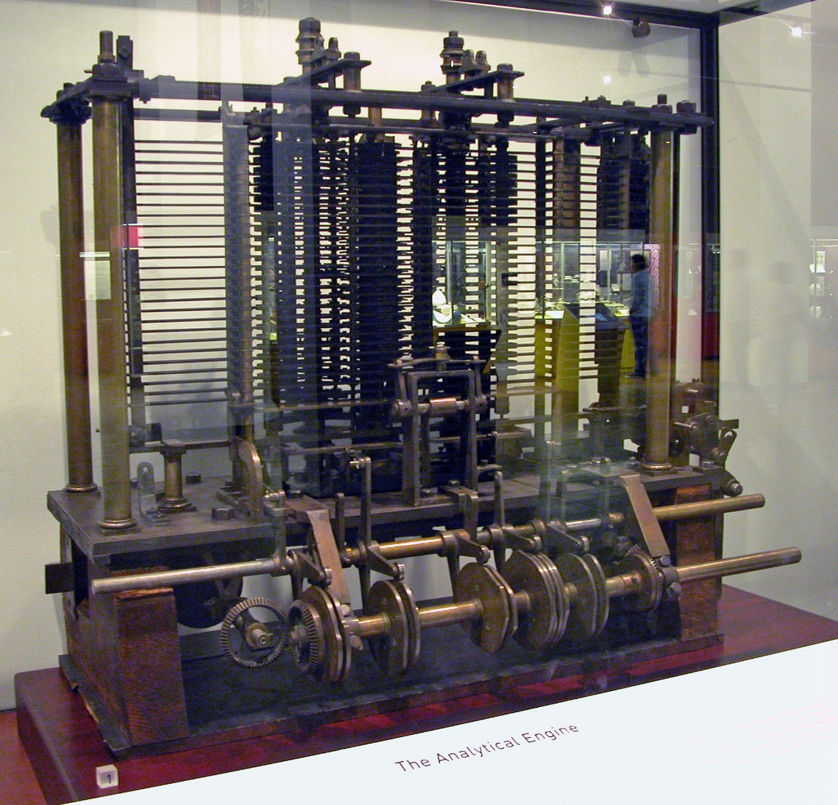
Where it began …
Charles Babbage and Ada Lovelace (circa 1800s)
Babbage devises his ‘analytic engine’. A mechanical computer with an Arithmetic Control Unit, Flow control, Branching, Loops, Memory…
Ada Lovelace contributed the ideas and
concepts which became a general
programming language for the analytic
engine. (Ever heard of the programming language ‘Ada’??)
All analog and mechanical; no electronic components!
By Bruno Barral (ByB), CC BY-SA 2.5, https://commons.wikimedia.org/w/index.php?curid=6839854
Notes:
Grady Booch on Architecture: https://rit.zoom.us/rec/play/vWrdyMMT0m2o4X4vCMWK-X2kVMLtsMIWMTjlXf1wVEvXp6nrVryRrwoanGX5r5gWDwG253GLh_09psm2.ziEm0lQwOxC_CMW4

Slide 4
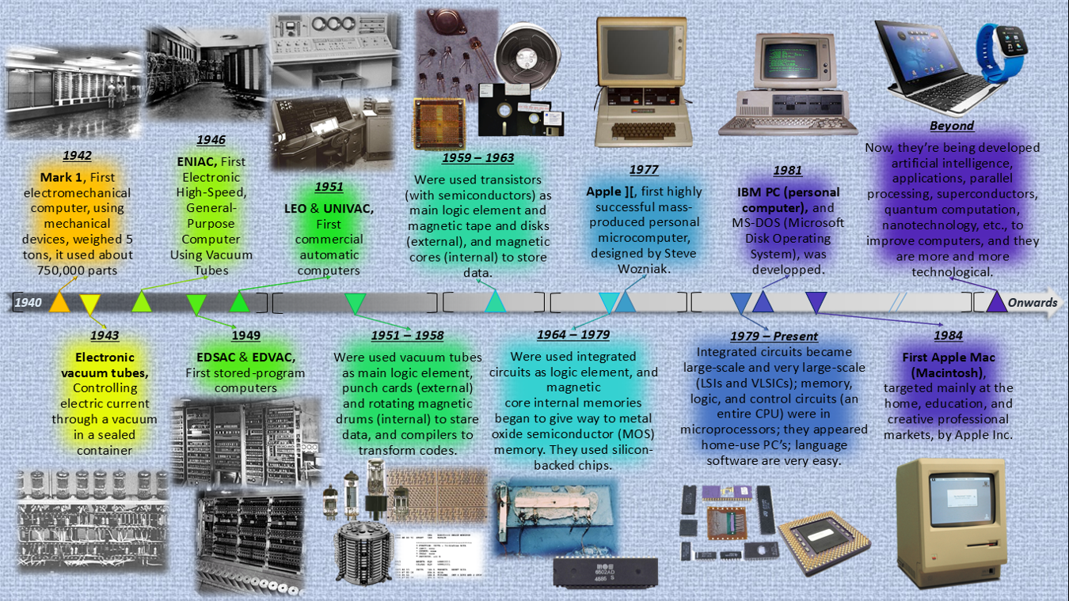
Ancestry.computer …
ENIAC: The first electronic computer. Completed in 1946 at the University of Pennsylvania.
EDVAC: von Neumann architecture
ICs (Integrated circuits aka ‘chips’) didn’t show up until the 60s!

Slide 5
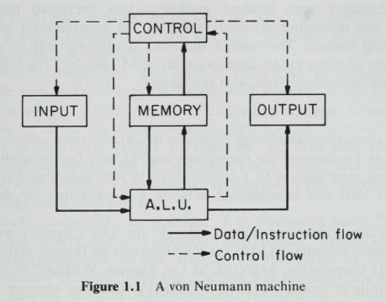
J. Baer, Computer Systems Architecture, Computer Science Press, p. 5, 1980

Slide 6
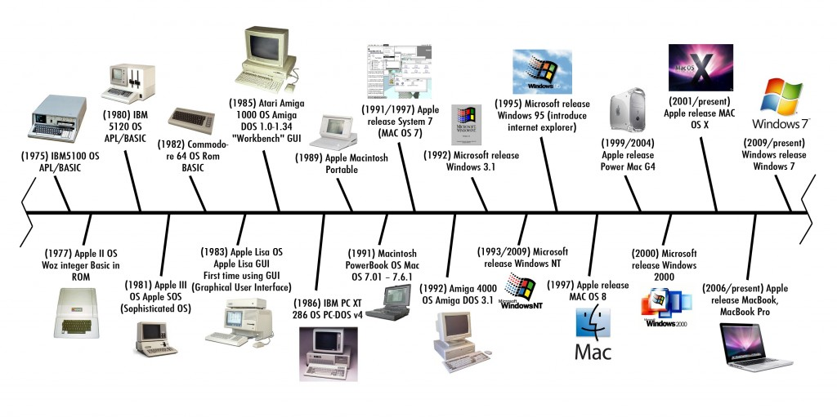
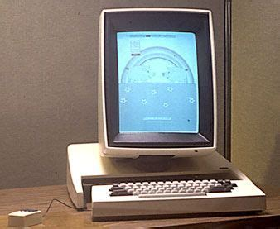
Ancestry.computer … for OS
Steve Jobs visits PARC
Xerox PARC Alto (1973!)
Notes:
Homebrew Computer Club – Menlo Park CA --

Slide 7
The evolution
Computers did not always look the way they do now
In fact they were once base-10, not base-2
EBCDIC was used instead of ASCII
The original goal was just crunch numbers (math) very very fast (e.g. Alan Turing’s Enigma project)
The standard today, is binary, high density chips, multiprocessing
The future?
- Quantum Computing (https://www.ibm.com/quantum-computing/learn/what-is-quantum-computing)
- Neuromorphic Computing (R. A. Nawrocki, R. M. Voyles and S. E. Shaheen, "A Mini Review of
Neuromorphic Architectures and Implementations," in IEEE Transactions on Electron Devices, vol. 63, no. 10, pp. 3819-3829, Oct. 2016, doi: 10.1109/TED.2016.2598413)
Notes:
CDC 6600 – memory cost and why 60 bit words.

Slide 8
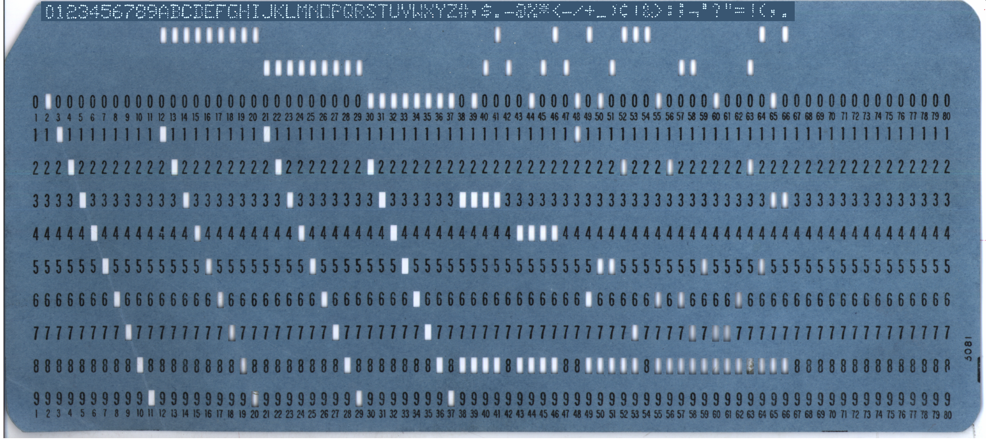
BCD – Binary Coded Decimal
History of Punched Cards: https://homepage.divms.uiowa.edu/~jones/cards/codes.html

Slide 9
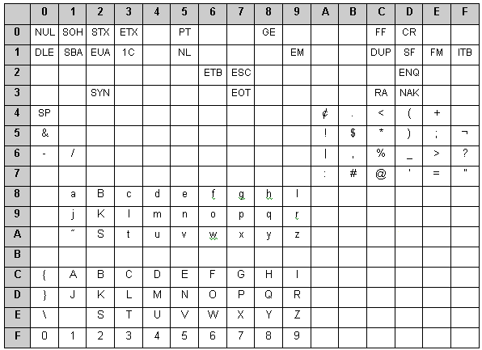
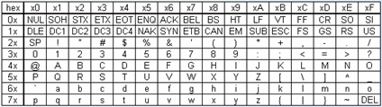
EBCDIC vs ASCII
Notes:
EBCDIC – Extended Binary Coded Decimal Interchange Code

Slide 10
But today: Your software on a computer … looks like this
Application
High level language
OS/ Drivers
Compiled libraries
Instruction Set
Binary
CPU
Memory
I/O
Circuits/ Devices

Slide 11
From code to CPU
8085 programming item | Description
Registers | These are 8 bit general purpose registers such as B,C,D,E,H,L as mentioned.
Accumulator | It is a 8 bit register used to store the result as well as intermediate operations of the mathematical operation.
Flags | These are five flags , set and reset according to certain arithmetic and logical conditions.
Program Counter(PC) | It is 16 bit in size. The microprocessor uses this register to sequence the executions of the instructions. It is also used as memory pointer. It holds memory address from where next byte is to be fetched. It basically points to the assembly codes stored in the form of opcodes. When a byte is fetched , PC is incremented by 1 to point to the next memory location.
Stack Pointer (SP) | It is 16 bit in size. It points to the memory location in R/W memory known as stack. The beginning of stack is defined by loading 16 bit address in the SP.
We all know that CPUs run architecture specific instruction sets
Compilers take programming languages and convert to assembly and then binary
X86, ARM, PowerPC all use different instruction sets (with similar behavior)

Slide 12
From code to CPU
x86 examples
MVI D, 8CH
MVI C, 6EH
MOV A, C
ADD D
OUT PORT1
HLT
MVI A, 40H
RLC
RLC
RLC
OUT PORT1
HLT
What does this do?
What does this do?
Adds x8C and x6E = xFA (250)
Multiply by 8 (shift is x2)

Slide 13
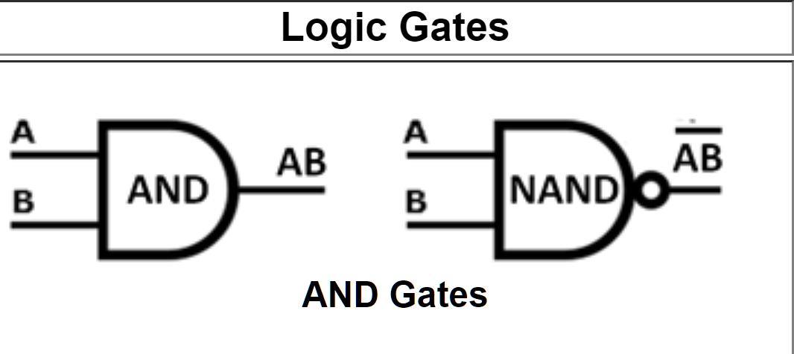
From there …
CPUs are circuitry
Transistors are the foundation of circuitry
Computers are digital logic; logic gates built from transistors
CPUs are made of millions of (transistors/ logic gates)
Binary instructions operate on these logic gates
What is a logic gate?
AND, NAND, OR, NOR, NOT, XOR …

Slide 14

Concept behind Logic … truth tables
 | A | B | AB | __ AB
Row1 | 0 | 0 | 0 | 1
Row2 | 0 | 1 | 0 | 1
Row3 | 1 | 0 | 0 | 1
Row4 | 1 | 1 | 1 | 0
What is the Software statement that corresponds to the logic gate diagram for output AB?
if (A && B) { …}
What is the Software statement that corresponds to the logic gate diagram for output
if ! (A && B) { …}

Slide 15
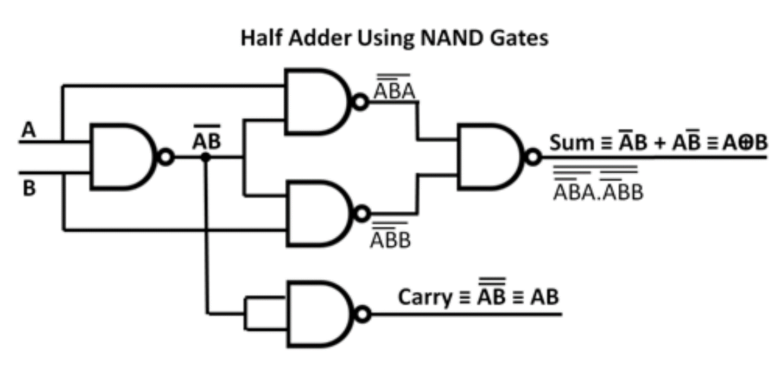
All math operations subset to digital logic
Subtraction is also addition in digital logic
Subtraction
To subtract binary number B (the subtrahend) from binary number A (the minuend).
  Add the 2's complement of B to A
  If there is a final carry bit, discard it and the result is positive.
  If B greater than A there will be no carry bit and the result will be the 2's complement of the sum and is negative.
Notes:
Half adder adds two single binary digits and provides a sum and carry value.

Slide 16
A simple ‘if’ statement
if (a == 0 and b != 0)
A
(MOSTLY CORRECT) ASSEMBLY CODE
&a = 0x5100; & b = 0x5200
LDA 0x5100
CMP 0
JZ SKIP
LDA 0x5200
JZ SKIP
BLAH, BLAH
SKIP: OTHER STUFF
B
Converted to digital logic, 2 logic gates
Roughly 8 transistors (2-5 per gate)
One simple line of code needs 8 transistors
Linux (just the kernel) has 10,000,000 lines of code

Slide 17
Reading material
Digital Logic:
https://mpoweruk.com/digital_logic.htm
Digital logic gates simulator:
https://www.kolls.net/gatesim/

Slide 18
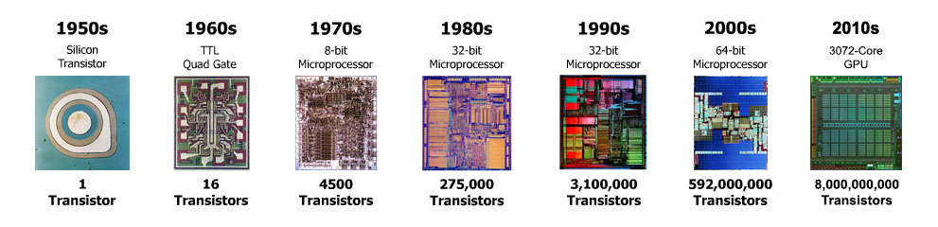
And this is why Moore’s law is important!
Always know your history so you can build the future
Notes:
The number of transistors on a integrated circuit doubles roughly every two years…

Slide 19
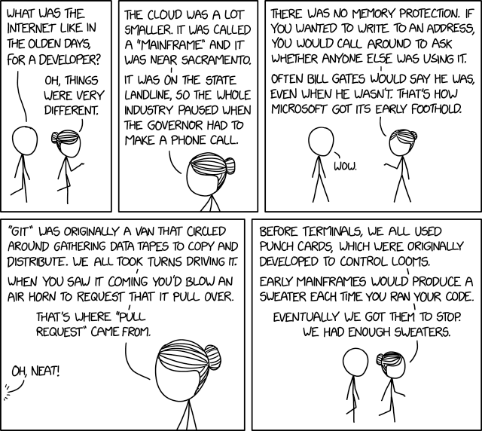
https://xkcd.com/2324/

